Slide 1

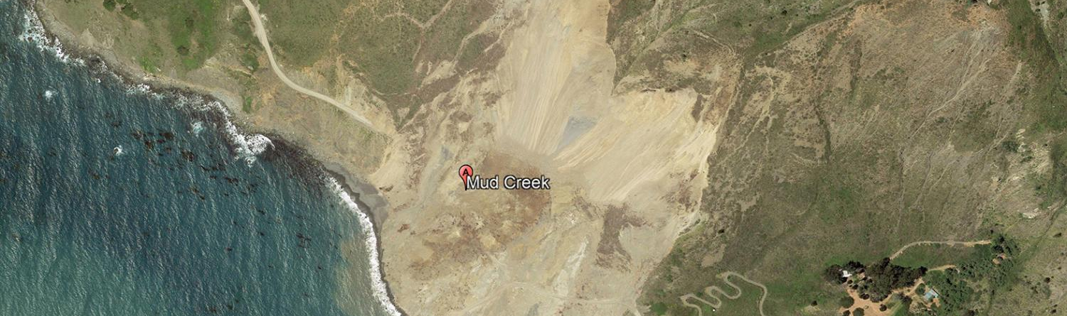
AI-POWERED LANDSLIDE REGION MAPPING USING SEMANTIC SEGMENTATION
Suraj Karki
25.08.2025
Dr.-Ing. Constanze Schwan
Notes:
HAW

Slide 2
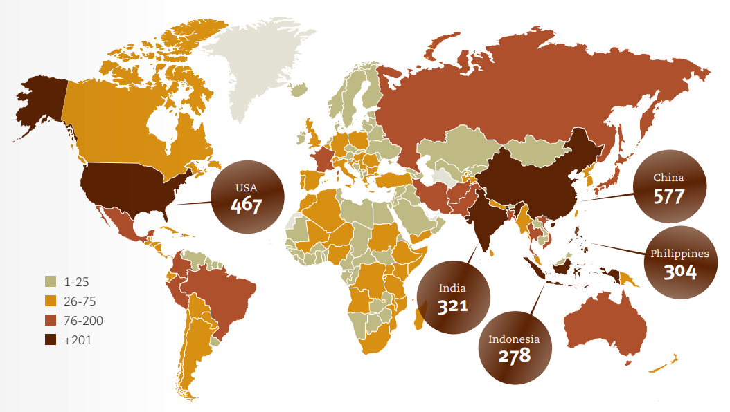
Introduction
Landslides are one of the most common and dangerous natural disasters globally
It causes significant damage to infrastructure, agriculture, and human life
According to the UNDRR, over 4,000 people die each year globally due to landslides ¹
Rapid post-disaster mapping is vital for guiding rescue efforts and risk assessment
1. UNDRR, Human Cost of Disasters: An Overview of the Last 20 Years (2000–2019), United Nations Office for Disaster Risk Reduction, 2020. [Online]. Available: https://www.undrr.org/publication/human-cost-disasters-overview-last-20-years-2000-2019
AI-Powered Landslide Region Mapping using Semantic Segmentation | Hochschule Bielefeld | 25.08.2025 | Page 2
Notes:
HAW

Slide 3
Problem statement
Manual mapping of landslide areas in post landslide assessment is slow, inconsistent, and risky.
Precise, up-to-date landslide masks are needed for:
Damage assessment
Recovery planning
Updating geohazards maps
A system is required to automatically generate post-landslide maps
AI-Powered Landslide Region Mapping using Semantic Segmentation | Hochschule Bielefeld | 25.08.2025 | Page 2
Notes:
HAW

Slide 4
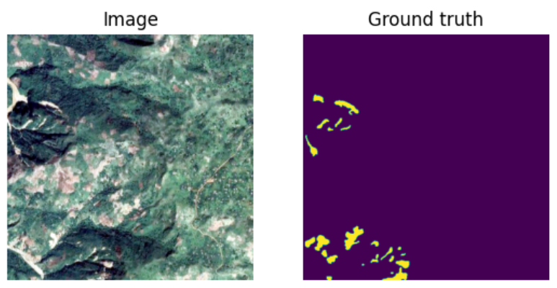
objective
To develop a deep learning model for precise landslide mapping
To obtain high performance in segmenting landslide regions from satellite and UAV imagery
To enable real-time monitoring and support disaster management efforts
Figure Source: Zhao et al. (2023), A global dataset of landslide inventories compiled from satellite imagery. Scientific Data. https://doi.org/10.1038/s41597-023-02847-z
AI-Powered Landslide Region Mapping using Semantic Segmentation | Hochschule Bielefeld | 25.08.2025 | Page 2
Notes:
HAW

Slide 5
State of the art
Points
Sub-points
AI-Powered Landslide Region Mapping using Semantic Segmentation | Hochschule Bielefeld | 25.08.2025 | Page 2
Notes:
HAW

Slide 6
Data acquisition
Landslide4Sense Dataset
Source: Institute of Advanced Research in Artificial Intelligence (IARAI)
Regions: Collected from four regions (Iburi, Kodagu, Rasuwa, Taitung)
Include earthquake and rainfall triggers landslide
Satellite: Sentinel-2
Topographic: ALOS (Advanced Land Observing Satellite
Acquisition Process: Data aggregated from public satellite archives
Annotation Process: annotations via Object-Based Image Analysis (OBIA)
Source: O. Ghorbanzadeh et al., "Landslide4Sense: Reference benchmark data and deep learning models for landslide detection," IEEE Trans. Geosci. Remote Sens., vol. 60, pp. 1–17, 2022, doi: 10.1109/TGRS.2022.3215209.
AI-Powered Landslide Region Mapping using Semantic Segmentation | Hochschule Bielefeld | 25.08.2025 | Page 2
Notes:
HAW

Slide 7
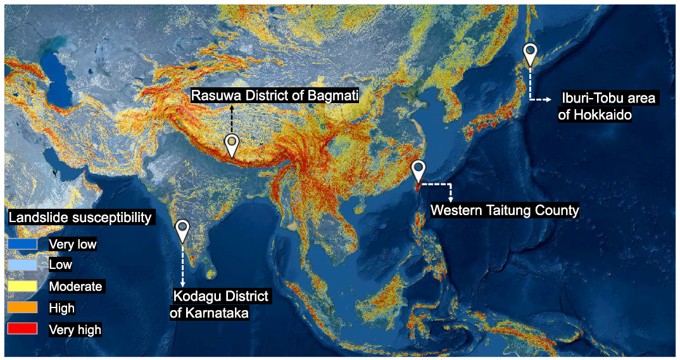
Data acquisition
Landslide4Sense Dataset
Figure Source: O. Ghorbanzadeh et al., "Landslide4Sense: Reference benchmark data and deep learning models for landslide detection," IEEE Trans. Geosci. Remote Sens., vol. 60, pp. 1–17, 2022, doi: 10.1109/TGRS.2022.3215209.
AI-Powered Landslide Region Mapping using Semantic Segmentation | Hochschule Bielefeld | 25.08.2025 | Page 2
Notes:
HAW

Slide 8
Data acquisition
CAS Landslide Dataset
Source: Institute of Mountain Hazards and Environment, Chinese Academy of Sciences.
Regions: Collected from nine diverse region
Include earthquake and rainfall triggers landslide
Satellite: Sentinel-2, Landsat, WorldView2/3, Planet, SuperView-1, GF-1
UAV: High-resolution imagery from Sichuan Geomatics Center and partners.
Acquisition Process: Satellite data sourced via Google Earth Engine, Digital Globe, and authorized providers; UAV data collected through drone
Source: Y. Xu, C. Ouyang, Q. Xu, D. Wang, B. Zhao, and Y. Luo, "CAS Landslide Dataset: A large-scale and multisensor dataset for deep learning-based landslide detection," Sci. Data, vol. 11, no. 12, Jan. 2024, Art. no. 12, doi: 10.1038/s41597-023-02847-z.
AI-Powered Landslide Region Mapping using Semantic Segmentation | Hochschule Bielefeld | 25.08.2025 | Page 2
Notes:
HAW

Slide 9
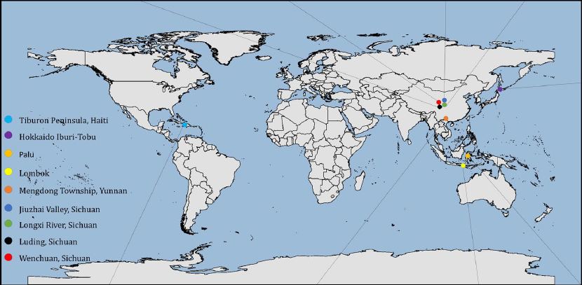
Data acquisition
Annotation Process
Pixel-level annotations created using QGIS and LabelMe
guided by landslide inventories, verified by geologists, cross-checked by team
Figure Source: Y. Xu, C. Ouyang, Q. Xu, D. Wang, B. Zhao, and Y. Luo, "CAS Landslide Dataset: A large-scale and multisensor dataset for deep learning-based landslide detection," Sci. Data, vol. 11, no. 12, Jan. 2024, Art. no. 12, doi: 10.1038/s41597-023-02847-z.
AI-Powered Landslide Region Mapping using Semantic Segmentation | Hochschule Bielefeld | 25.08.2025 | Page 2
Notes:
HAW

Slide 10
Data structure
Landslide4Sense Dataset
Total Input: 3,799 images (128x128 pixels, 14 channels).
Channels: 12 Sentinel-2 bands (B1–B12), ALOS PALSAR slope (B13), DEM (B14).
Output: 128x128x1 binary mask
Split:
Training: 3,799, Validation: 245, Testing: 800
Distribution:
Train Set: 2,231 landslide, 1,568 non-landslide;
Valid Set: 146 landslide, 99 non-landslide;
Test Set: Test: 536 landslide, 264 non-landslide.
AI-Powered Landslide Region Mapping using Semantic Segmentation | Hochschule Bielefeld | 25.08.2025 | Page 2
Notes:
HAW

Slide 11
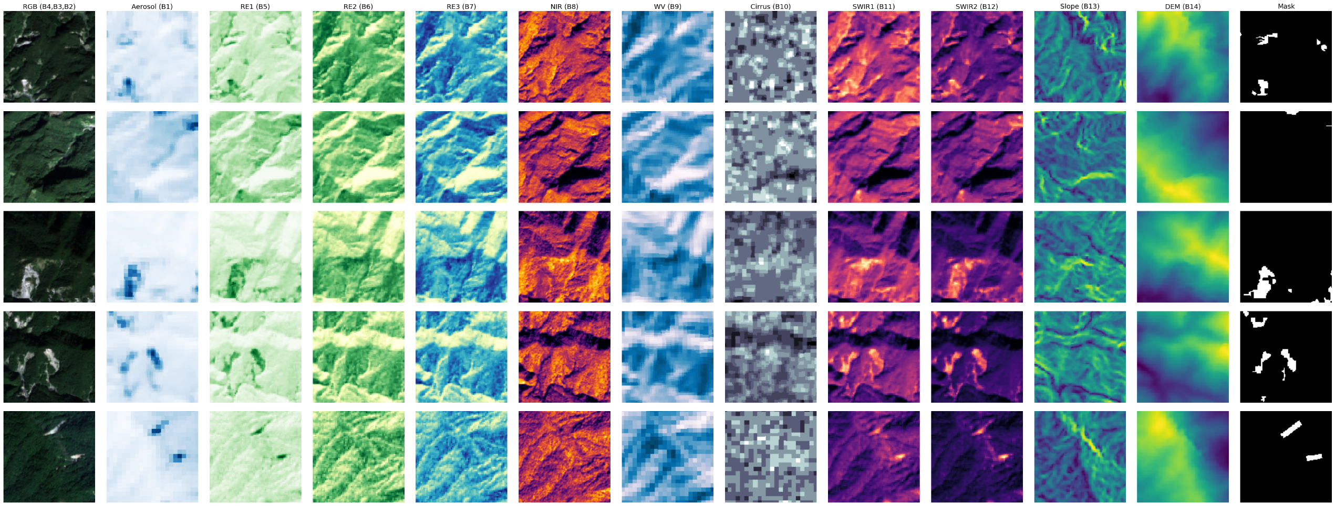
Data structure
Bands
AI-Powered Landslide Region Mapping using Semantic Segmentation | Hochschule Bielefeld | 25.08.2025 | Page 2
Notes:
HAW

Slide 12
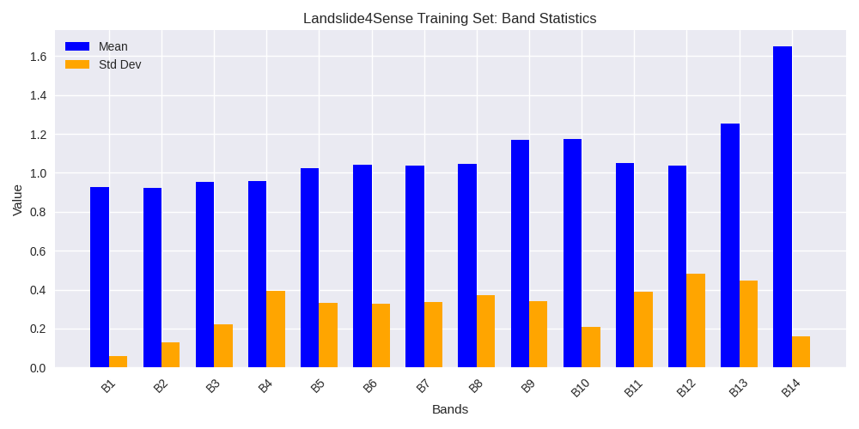
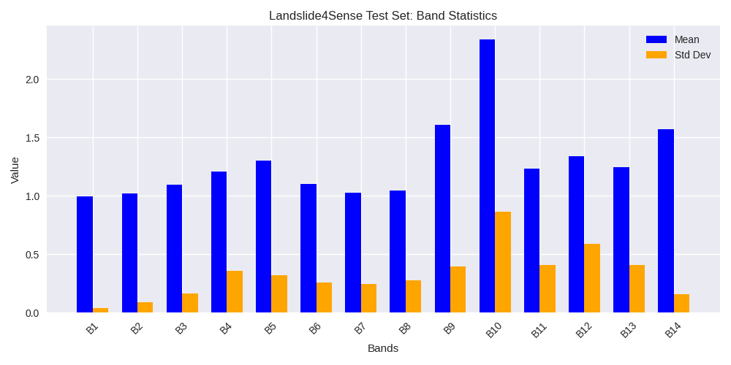
Data structure
Landslide4Sense Dataset
Band Statistics:
AI-Powered Landslide Region Mapping using Semantic Segmentation | Hochschule Bielefeld | 25.08.2025 | Page 2
Notes:
HAW

Slide 13
Data structure
CAS Landslide Dataset
Set 1: UAV
Total Inputs: 10,939 images (512x512 pixels, 3 channels)
Channels: RGB
Output: 512x512x1 binary mask
Split:
Training: 8,753, Validation: 1093, Testing: 1093
Distribution
All images have landslide region
AI-Powered Landslide Region Mapping using Semantic Segmentation | Hochschule Bielefeld | 25.08.2025 | Page 2
Notes:
HAW

Slide 14
Data structure
CAS Landslide Dataset
Set 2: Satellite
Total Inputs: 7,422 images (512x512 pixels, 3 channels)
Channels: RGB
Output: 512x512x1 binary mask
Split:
Training: 5,938, Validation: 742, Testing: 742
Distribution
All images have landslide region
AI-Powered Landslide Region Mapping using Semantic Segmentation | Hochschule Bielefeld | 25.08.2025 | Page 2
Notes:
HAW

Slide 15
Data structure
UAV Data:
Subdataset | Amount | Acquisition Time | Source | Sensor | Ground Resolution (m)
Moxitaidi | 984 | 2022.09–2022.10 | Sichuan Geomatics Center | UAV | 0.6
Moxitaidi | 483 | 2022.09–2022.10 | Sichuan Geomatics Center | UAV | 1
Moxi Town | 1635 | 2022.09–2022.10 | Sichuan Geomatics Center | UAV | 0.2
Moxi Town | 160 | 2022.09–2022.10 | Sichuan Geomatics Center | UAV | 1
Longxi River | 2504 | 2011.03–2011.05 | Sichuan Geomatics Center | UAV | 0.5
Jiuzhai Valley | 5925 | 2017.08–2017.09 | Sichuan Geomatics Center | UAV | 0.2
Jiuzhai Valley | 1752 | 2017.08–2017.09 | Sichuan Geomatics Center | UAV | 0.5
AI-Powered Landslide Region Mapping using Semantic Segmentation | Hochschule Bielefeld | 25.08.2025 | Page 2
Notes:
HAW

Slide 16
Data structure
Satellite Data:
Subdataset | Amount | Acquisition Time | Source | Sensor | Ground Resolution (m)
Palu | 817 | 2021.01–2021.11 | Digital Globe Open Data Program | WorldView2/3 | 5
Lombok | 436 | 2019.05–2019.12 | Digital Globe Open Data Program | WorldView2/3 | 5
Hokkaido Iburi-Tobu | 1484 | 2018.09–2018.10 | Geospatial Information Authority of Japan | SAT | 3
Tiburon Peninsula (Sentinel) | 606 | 2020.03–2020.06 | European Space Agency | Sentinel-2/L2A | 5
Tiburon Peninsula (Planet) | 325 | 2021.09–2021.12 | Planet | Planet | 4
Mengdong | 1155 | 2018.11.04 | Beijing Lanyu Fangyuan Technology Co., Ltd. | SuperView-1 | 0.5
Moxitaidi (SAT) | 652 | 2022.09–2022.10 | European Space Agency | Sentinel-2/L2A | 0.6
Longxi River (SAT) | 1769 | 2015.03–2015.12 | China Centre for Resources Satellite Data and Application | GF-1 | 0.5
Wenchuan | 178 | 2008.11–2008.12 | U.S. Geological Survey | Landsat | 5
AI-Powered Landslide Region Mapping using Semantic Segmentation | Hochschule Bielefeld | 25.08.2025 | Page 2
Notes:
HAW

Slide 17
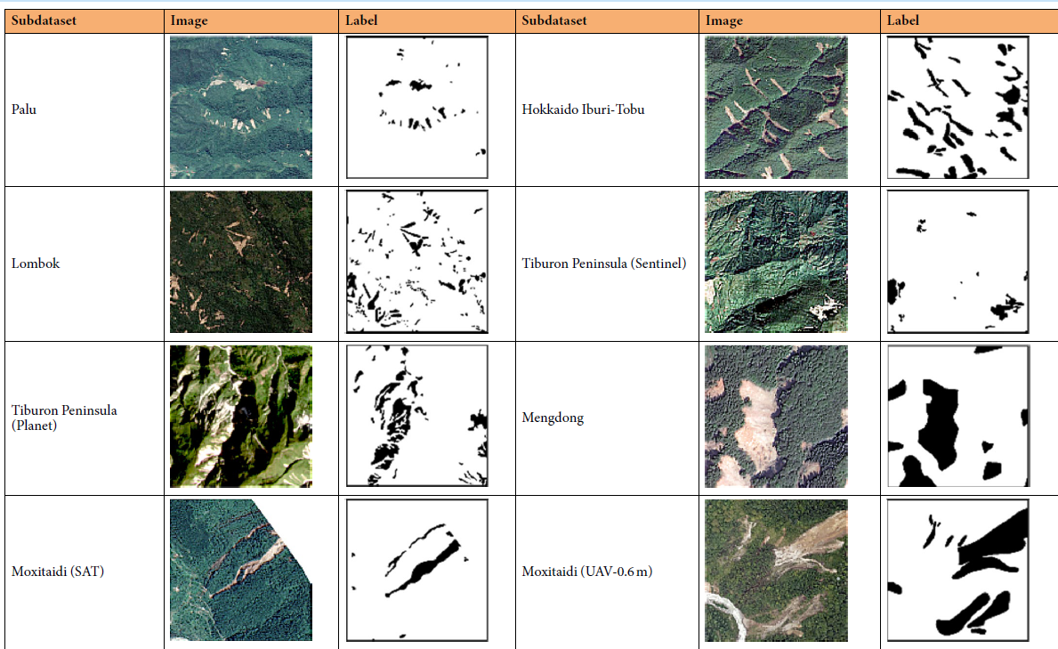
Data structure
Figure Source: Y. Xu, C. Ouyang, Q. Xu, D. Wang, B. Zhao, and Y. Luo, "CAS Landslide Dataset: A large-scale and multisensor dataset for deep learning-based landslide detection," Sci. Data, vol. 11, no. 12, Jan. 2024, Art. no. 12, doi: 10.1038/s41597-023-02847-z.
AI-Powered Landslide Region Mapping using Semantic Segmentation | Hochschule Bielefeld | 25.08.2025 | Page 2
Notes:
HAW

Slide 18
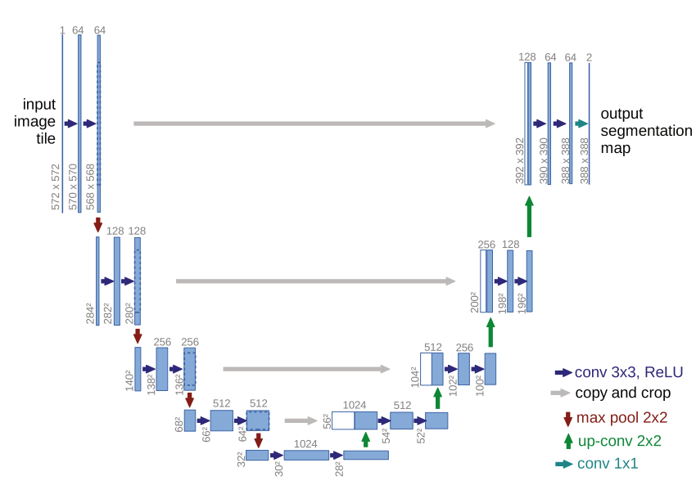
ML models
1. Unet
A FCN originally designed for biomedical image segmentation.
Widely used in remote sensing for image classification and
object detection, including landslide detection
Encoder: Captures low-level features
Decoder: Captures high-level features and reconstructs image
Skip Connections: preserve fine-grained details and improve
accuracy.
Source: O. Ronneberger, P. Fischer, and T. Brox, “U-Net: Convolutional networks for biomedical image segmentation,” in Proc. Int. Conf. Med.
Image Comput.-Assist. Intervent. Cham, Switzerland: Springer, 2015, pp. 234–241.
AI-Powered Landslide Region Mapping using Semantic Segmentation | Hochschule Bielefeld | 25.08.2025 | Page 2
Notes:
HAW

Slide 19
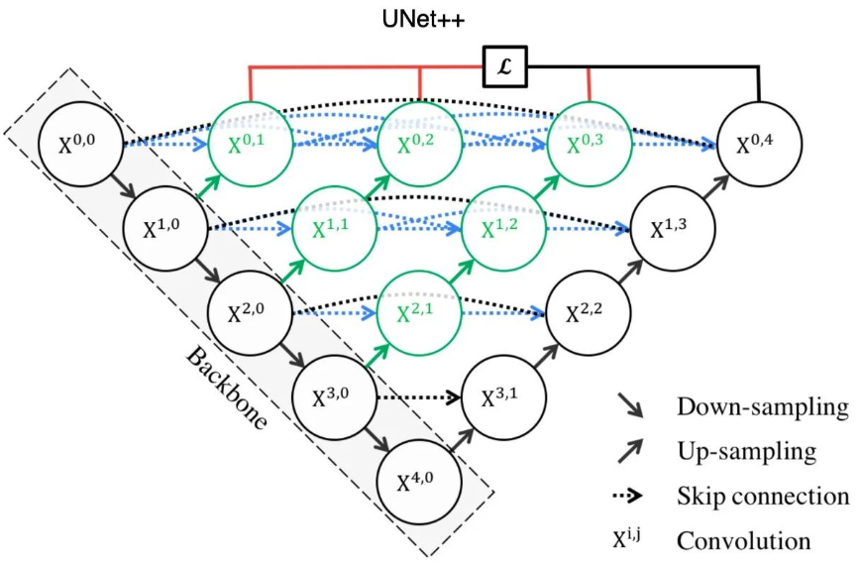
ML models
2. Unet++
An improved version of U-Net
redesigned skip pathways (shown in green): bridges the
semantic gap between encoder and decoder
dense skip connections (shown in blue)
deep supervision (shown in red): allows pruning to trade off speed and accuracy by using multiple output branches.
Enhances feature fusion for improved accuracy and gradient flow.
Source: https://jinglescode.github.io/2019/12/02/biomedical-image-segmentation-u-net-nested/
AI-Powered Landslide Region Mapping using Semantic Segmentation | Hochschule Bielefeld | 25.08.2025 | Page 2
Notes:
HAW

Slide 20
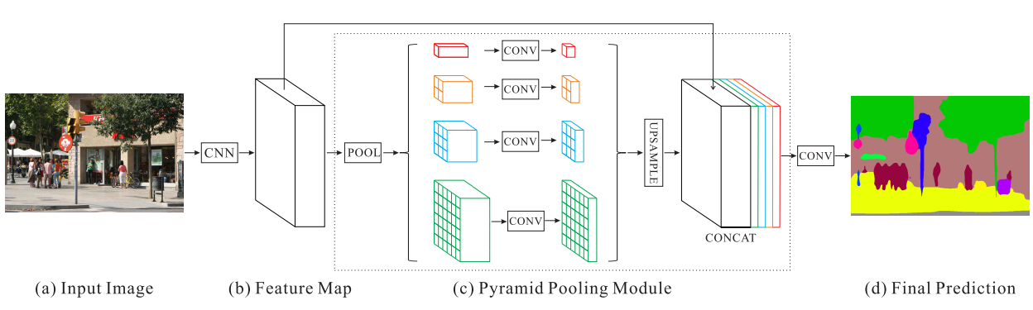
ML models
3. PSPNet
Uses pyramid pooling to learn global context information
Applies regional aggregation to capture multi-scale
features
Fuses features from four different pyramid scales
Achieves effective multi-scale feature learning
Can able to efficiently work with variable size objects of the image
Source: H. Zhao, J. Shi, X. Qi, X. Wang and J. Jia, "Pyramid Scene Parsing Network," 2017 IEEE Conference on Computer Vision and Pattern Recognition (CVPR), Honolulu, HI, USA, 2017, pp. 6230-6239, doi: 10.1109/CVPR.2017.660.
AI-Powered Landslide Region Mapping using Semantic Segmentation | Hochschule Bielefeld | 25.08.2025 | Page 2
Notes:
HAW

Slide 21
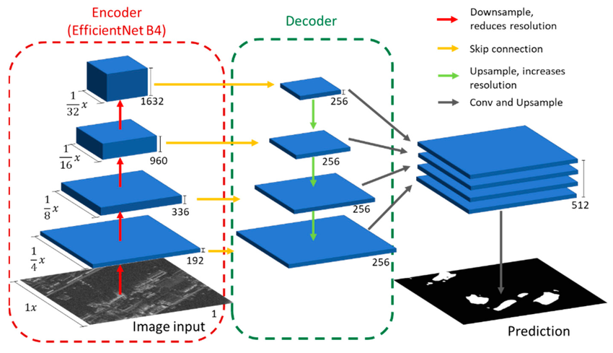
ML models
4. FPN
Designed for multi-scale segmentation
Builds a top-down feature pyramid from deep to shallow
layers
Combines low-resolution semantic-rich features
with high-resolution spatial-rich features
Enhances segmentation of small, medium, and large objects
Source: Wangiyana, Sandhi & Samczynski, Piotr & Gromek, Artur. (2022). Data Augmentation for Building Footprint Segmentation in SAR Images: An Empirical Study. Remote Sensing. 14. 2012. 10.3390/rs14092012.
AI-Powered Landslide Region Mapping using Semantic Segmentation | Hochschule Bielefeld | 25.08.2025 | Page 2
Notes:
HAW

Slide 22
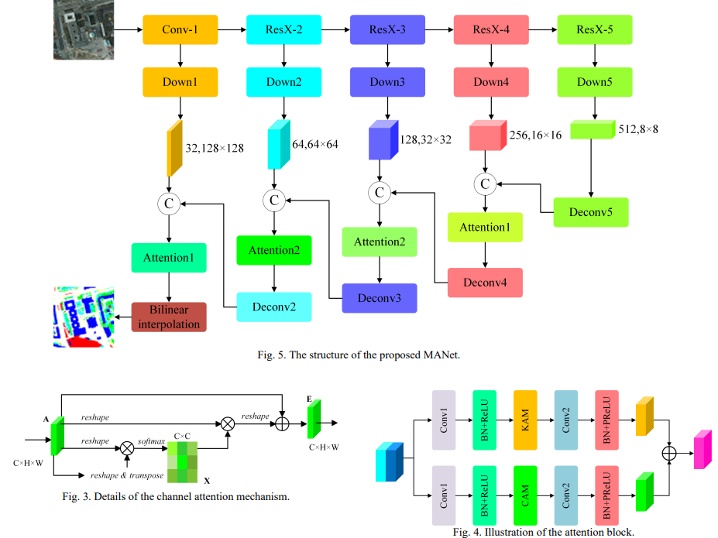
ML models
5. MANet
Focuses on fine-grained semantic segmentation
Utilizes multi-scale feature extraction for diverse
object sizes
Incorporates attention mechanisms to highlight
important regions
Enhances boundary details and small object recognition
Suitable for complex and cluttered scenes like satellite images
Source: R. Li, S. Zheng, C. Zhang, C. Duan, J. Su, L. Wang, and P. M. Atkinson, “Multiattention Network for Semantic Segmentation of Fine-Resolution Remote Sensing Images,” IEEE Transactions on Geoscience and Remote Sensing, vol. 60, pp. 1–13, 2022, doi: 10.1109/TGRS.2021.3093977.
AI-Powered Landslide Region Mapping using Semantic Segmentation | Hochschule Bielefeld | 25.08.2025 | Page 2
Notes:
HAW

Slide 23
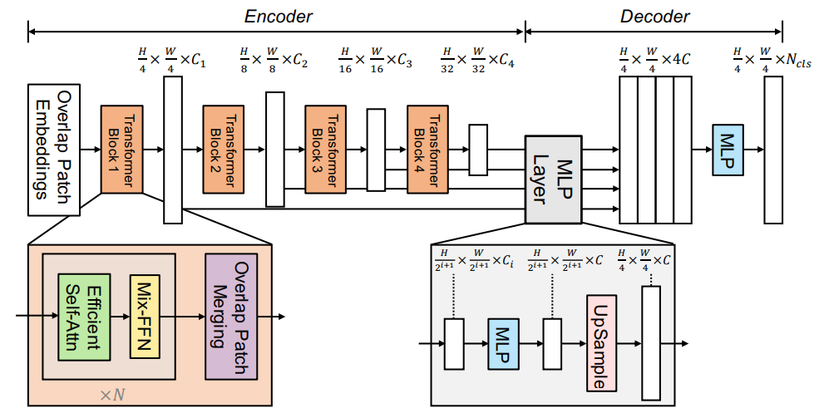
ML models
6. Segformer
Transformer-based architecture for semantic segmentation
Hierarchical Transformer encoder: extract coarse
and fine features
Lightweight MLP decoder: directly fuse these multi-level
features and predict the semantic segmentation mask
Achieves strong accuracy–efficiency trade-off for high-resolution images
FFN: Feed-forward Network
Source: E. Xie, W. Wang, Z. Yu, A. Anandkumar, J. M. Alvarez, and P. Luo, “SegFormer: Simple and Efficient Design for Semantic Segmentation with Transformers,” arXiv preprint arXiv:2105.15203, 2021. [Online]. Available: https://arxiv.org/abs/2105.15203
AI-Powered Landslide Region Mapping using Semantic Segmentation | Hochschule Bielefeld | 25.08.2025 | Page 2
Notes:
HAW

Slide 24
fine-tuning
Fine-tuning is decided based on the available hardware resources, datasets, and project timeframe
Approach:
Used pre-trained encoders: by freezing the encoder weights (imagenet)
Resnet 18, Resnet34, Resnet50
Mobilenet V2
Densenet 161
Efficientnet-b2
Xception
Decoder part of the model is fine-tuned
AI-Powered Landslide Region Mapping using Semantic Segmentation | Hochschule Bielefeld | 25.08.2025 | Page 2
Notes:
HAW

Slide 25



fine-tuning
Experimental Setup
Hardware:
DA-Cluster: 8 CUDA-capable GPUs (NVIDIA Tesla P100, each with 12 GB)
Software:
Segmentation Models: Pytorch based library to build and train segmentatinon models
Streamlit: Python library to build interactive web apps
AI-Powered Landslide Region Mapping using Semantic Segmentation | Hochschule Bielefeld | 25.08.2025 | Page 2
Notes:
HAW

Slide 26
fine-tuning
Experimental Setup
Hyperparameters:
Batch Size: 8
Learning Rate: 0.001 (Adam optimizer, LRscheduler: Cosine Annealing )
Number of Epochs: 300
Loss Function: Focal Loss
Early Stopping to avoid overfitting
AI-Powered Landslide Region Mapping using Semantic Segmentation | Hochschule Bielefeld | 25.08.2025 | Page 2
Notes:
HAW

Slide 27
results
Points
Sub-points
AI-Powered Landslide Region Mapping using Semantic Segmentation | Hochschule Bielefeld | 25.08.2025 | Page 2
Notes:
HAW

Slide 28
discussion
Points
Sub-points
AI-Powered Landslide Region Mapping using Semantic Segmentation | Hochschule Bielefeld | 25.08.2025 | Page 2
Notes:
HAW

Slide 29
conclusion
Points
Sub-points
AI-Powered Landslide Region Mapping using Semantic Segmentation | Hochschule Bielefeld | 25.08.2025 | Page 2
Notes:
HAW

Slide 30

AI-Powered Landslide Region Mapping using Semantic Segmentation | Hochschule Bielefeld | 25.08.2025 | Page 2
Notes:
HAW

Slide 31

AI-Powered Landslide Region Mapping using Semantic Segmentation | Hochschule Bielefeld | 25.08.2025 | Page 2
Notes:
HAW

